Slide 1
18LEM109T Indian traditional knowledge
Submission by:
Vighnesh Pradhan (RA2011030010180)
Harshit Sharma (RA2011030010206)
Sooraj Tomar (RA2011030010224)

Slide 2
Presentation on Crop cultivation - Community based Environment friendly practices

Slide 3
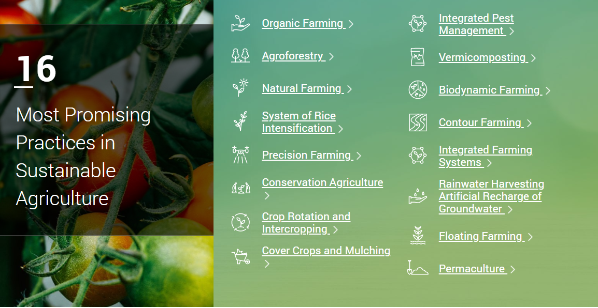

Slide 4
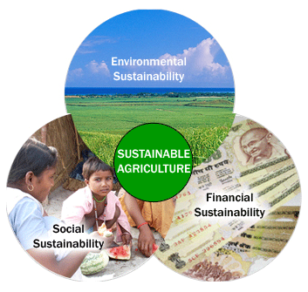

Slide 5
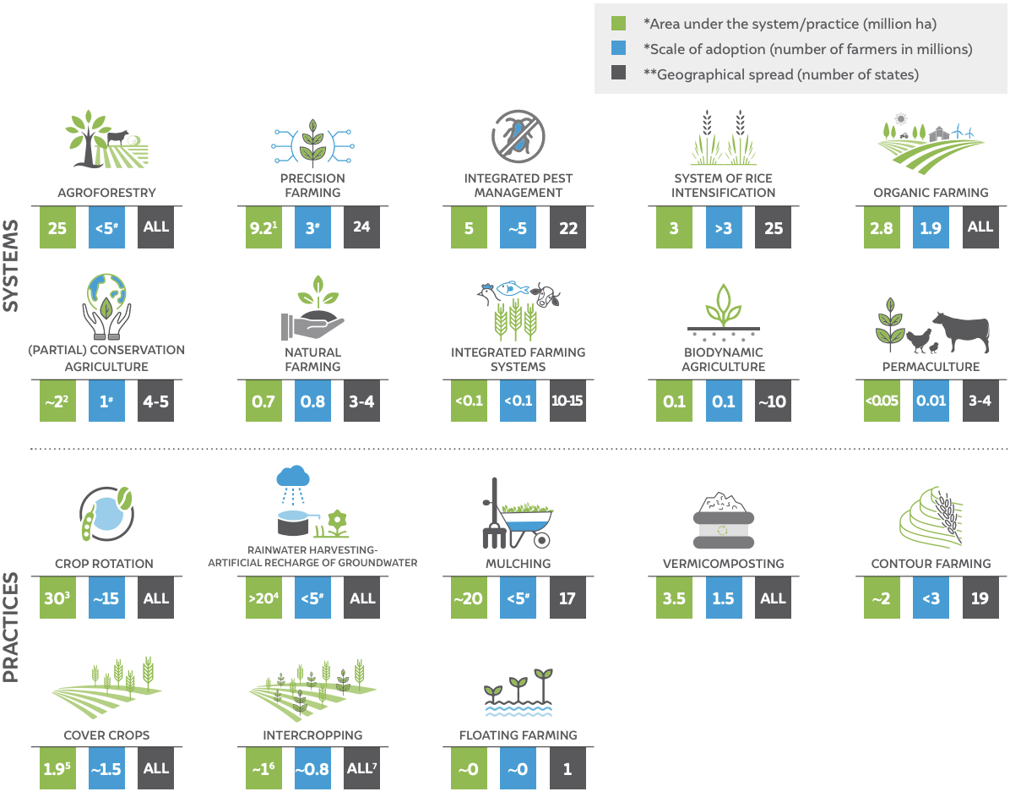
Sustainable agriculture practices and systems in India (2021) – key statistics

Slide 6
Organic farming in india
Organic farming is in a nascent stage in India. About 2.78 million hectare of farmland was under organic cultivation as of March 2020, according to the Union Ministry of Agriculture and Farmers’ Welfare. This is two per cent of the 140.1 million ha net sown area in the country.
A few states have taken the lead in improving organic farming coverage, as a major part of this area is concentrated only in a handful of states. Madhya Pradesh tops the list with 0.76 million ha of area under organic cultivation — that is over 27 per cent of India’s total organic cultivation area.
The top three states — Madhya Pradesh, Rajasthan and Maharashtra — account for about half the area under organic cultivation. The top 10 states account for about 80 per cent of the total area under organic cultivation.
Sikkim is the only Indian state to have become fully organic so far. A majority of the states have only a small part of their net sown area under organic farming. Even the top three states that account for the largest area under organic cultivation — Madhya Pradesh, Rajasthan and Maharashtra — have only around 4.9, 2.0 and 1.6 per cent of their net sown area under organic farming respectively.
A few states such as Meghalaya, Mizoram, Uttarakhand, Goa and Sikkim have 10 per cent or more of their net sown area under organic cultivation. All these states, except Goa, are in hilly regions.
Union Territories such as Delhi, Dadra and Nagar Haveli and Daman and Diu, Lakshadweep and Chandigarh also have 10 per cent or more of their net sown area under organic cultivation, but their agricultural area is very small. Almost all other states have less than 10 per cent of their net sown area under organic.

Slide 7
Getting back to nature
Millions of farmers in India have rejected chemical pesticides as part of a growing movement that favors natural alternatives. Non-pesticide management is a sustainable approach to pest control operating on the theory that an infestation of one type of insect indicates a disturbance somewhere in the environment. Getting to the root of the problem instead of treating the symptoms can both balance the insect population and improve crop health overall.
The switch to natural farming methods began as a grassroots movement. In 2000, the 900 or so villagers living in Punukula, Andhra Pradesh, suffered from a number of debilitating issues. Farmers reported health problems that ranged from acute poisoning to death. Pest infestations regularly destroyed crops as insects developed resistance, causing farmers to take out loans to buy an increasing number of expensive chemical pesticides. Families faced crippling healthcare costs, crop failure, loss of income, and debt, all directly related to pesticides.
With the help of local organizations, farmers experimented with non-pesticide management techniques like using natural deterrents (such as neem and chili pepper) to manage insects, and by planting trap crops (like marigold and castor). Whereas chemical pesticides kill all insects, non-pesticide management seeks to balance the ecosystem so that insects exist in normal numbers (and never reach infestation levels). Many insects – like ladybugs, dragonflies and spiders – have an important role in nature that can benefit plants.

Slide 8
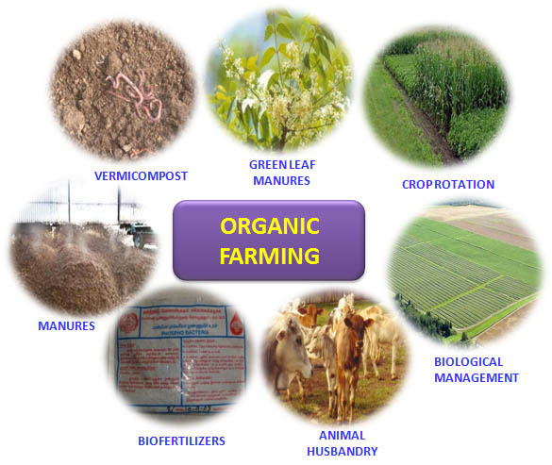

Slide 9
Important example of eco-friendly cultivation
The ancient Tamils cultivated a wide range of crops such as rice, sugarcane, millets, pepper, various grams, coconuts, beans, cotton, plantain, tamarind and sandalwood. Paddy was the main crop and different varieties of paddy such as Vennel, Sennel, Pudunel, Aivananel and Torai were grown in the wet land of Marutam. Sennel and pudunel were the more refined varieties. In a very fertile land, a Veli of land yielded 1000 Kalam of paddy. The peasants lived under the shady groves beyond the Marutam land. Each house had jack, coconut, palm, areca and plantain trees. Turmeric plants were grown in front of the houses and flower gardens were laid in between the houses. The Mullai people undertook the cultivation of fruit trees and crops for cattle. The sugarcane producers even employed mechanical contrivances to extract juices from it. In some plots, rotation of crops was followed – cotton and millet were grown simultaneously on a plot and after that, beans were cultivated on the same land. There, generally, was surplus from the produce. The Tamil people practiced a very systematic method of cultivation during the Sangam age. It was known that ploughing, manuring, weeding, irrigation and crop protection need to be followed in a proper way for the yield to be rich. Tiruvalluvar, in his Tirukkural, emphasizes the need for all of these steps to be undertaken in a careful manner in order to get a good yield. A paddy field was also known as Kalam and was ploughed with the help of oxen. Ploughed lands were leveled by the peasants using their feet, followed by the planting of the paddy seeds. Once the seeds grew into saplings, they were transplanted and when the crop was mature, it was harvested. Weeds were removed periodically. Paddy was removed from the harvested stalks by beating on the ground or by getting bullocks to tread on them. Cleared paddy was collected, measured and stored in proper containers. Millets were grown on the Pinpulam or the dry lands and in the Kurinji region. Crop rotation was followed – for instance, cotton and millets were grown simultaneously on the same plot and after that, beans were cultivated on it.

Slide 10
Important example of eco-friendly cultivation (contd…)
A wide range of tools needed for agriculture, from ploughing to harvesting, were manufactured. The basic tool was a plough also known as meli, nanchil and kalappai. It consists of a wooden plank to tie the oxen and an iron bar attached to the plank, that tilled the land. This tool helped to bring the low-lying soil to the upper layer and send the top layer to the bottom, thereby aerating the land. For digging earth, a spade with wooden handle and a sharp terminal was used. A wooden leveler known as palli or maram was used to level the ploughed land. Palliyadutal refers to the process of removing weeds by means of a toothed implement attached to a plank and drawn by oxen. Farmers used a bullock-propelled contrivance called Kapilai for bailing out water from deep wells and a manual setup called Erram, for shallow wells. Water bales were also known as ampi and kilar. Protecting the standing crops from stray animals and birds was an important activity and was carried out by young girls[8] and lower-class peasants. While the young girls used rattles to scare birds away, the Kuravan and Kurathi used a stone-sling device called Kavan to drive away elephants and birds. It is said that an accurate shot from the sling could even kill an animal. Bugles and burning torches were other mechanisms used to keep wild animals away from the fields. Sickles were used for harvesting fully grown paddy and reaping the ripe ears of corn. The paddy grain was separated by thrashing the sheaths on the ground. Ears of millets were stamped on by farm workers and that of black gram were beaten by a stick. During the early phases of the Sangam period, people depended heavily on rains as the primary source of water for agriculture. But, increasing demand stemming from a growing population led to the development of better methods of irrigation. Since the rivers of the region were not perennial, the primary goal was to procure an adequate and continuous supply of water. Tanks, lakes and dams wereimportant water storage systems that were developed for this purpose. Sluices and shutters were constructed for regulating water for irrigation.

Slide 11
Thank you

